Slide 1



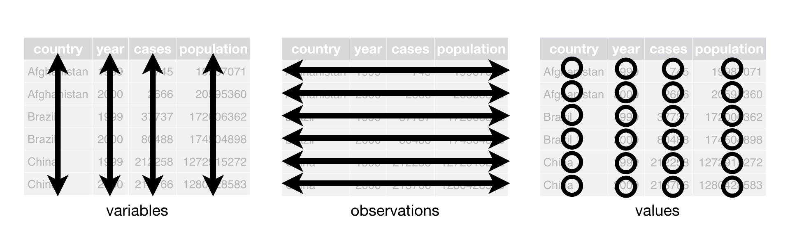
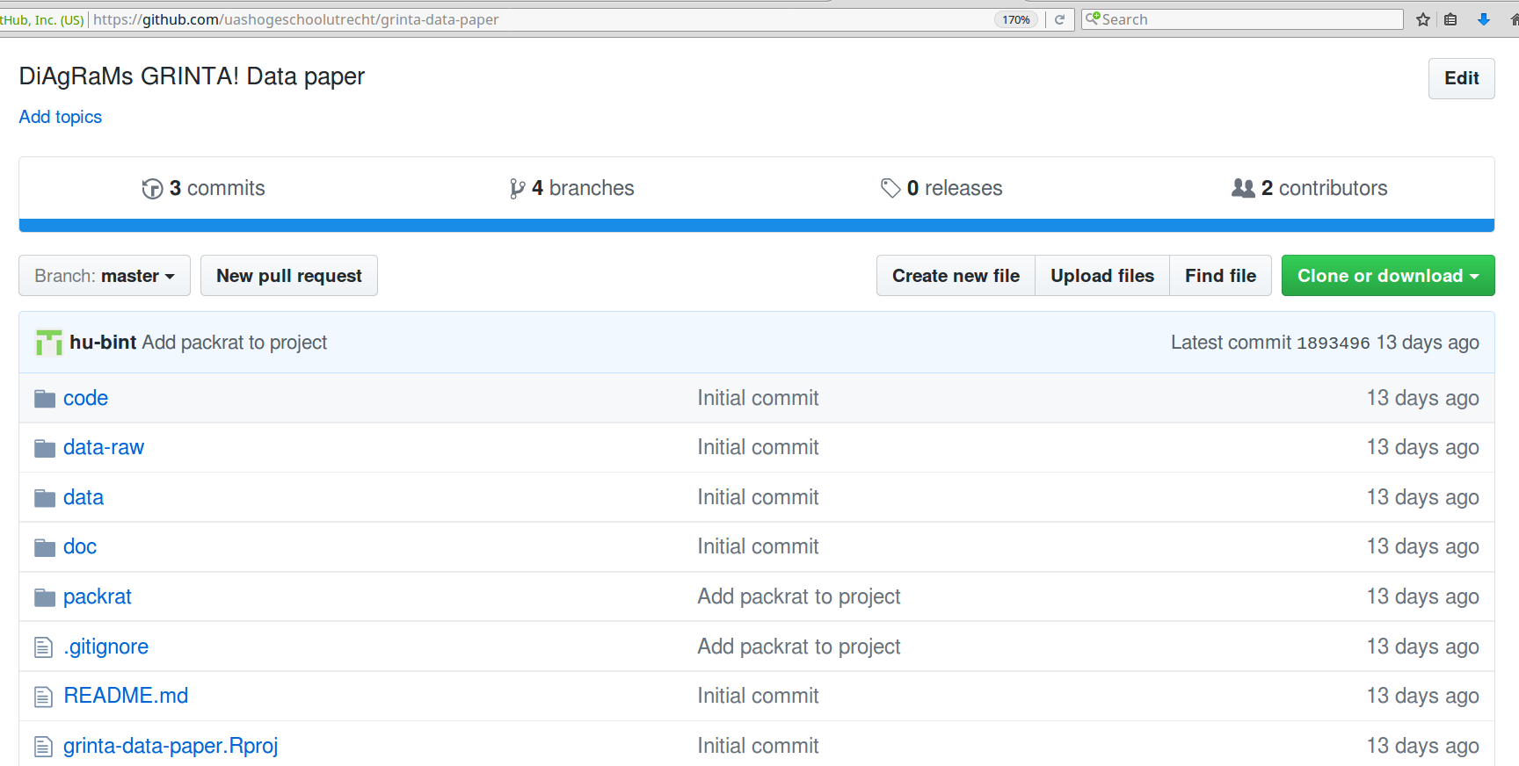
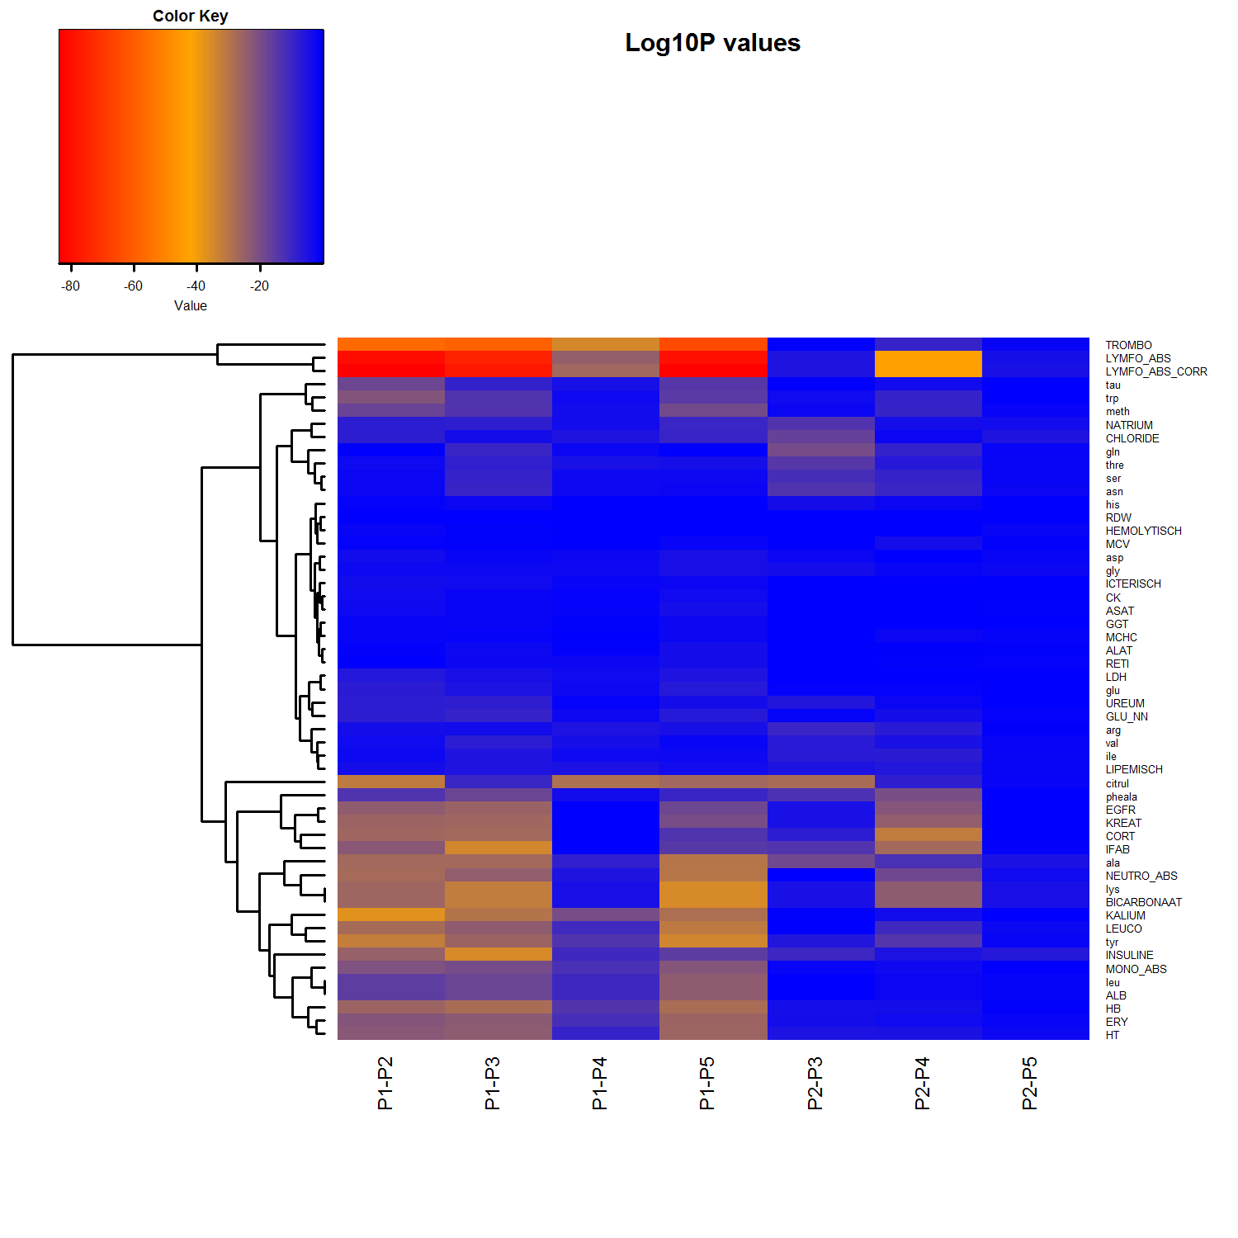
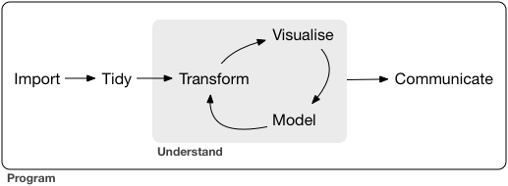
University of Applied Sciences
Research Centre Life Sciences & Chemistry
“grintar”; An R package to analyze, visualize and distribute data from a physical exercise ergometer model.
Marc Teunis^{1*}, Jan-Willem Lankhaar^{2*}, Shirley Kartaram¹, Eric Schoen³, Raymond Pieters^{1,4}
1) Innovative Testing in Life Sciences & chemistry, University of Applied Sciences, Utrecht
2) Institute for ICT, HBO-ICT , University of Applied Sciences, Utrecht
3) TNO, Zeist
4) Institute for Risk Assessment Sciences, Utrecht University, Utrecht
*Both authors contributed equally to this work
The ‘grintar’ package scope
The grintar package is an R-package under development to share, clean, analyze and distribute data and r-code from our “GRINTA!” study. “GRINTA!” is the name for a study
perfomed within the RAAK PRO “DiAgRaMs” project. This project focuses on the discovery of biomarkers, specific for health status of humans. In the first study of this
project 15 healthy trained young men were exposed to 4 different bike-ergometer exercise protocols, and a non-exercise protocol that served as a negative control.
Over a 100 different biological parameters were determined in blood, urine and saliva taken from the subjects during and after exercise. The volunteers wererequested
to follow dietary restrictions and to keep a diary. Sets of parameters were determined in different laboratories. Data was recieved as MS Office Excel or text-delimited files.
All data cleaning,
combining, visualization and analyses were performed in R in conjunction with Rstudio.
Programming rules and prerequisites
The package has been written according a number of programming rules
(Hadley & Groleumnd, 2017; Rigde, 2015) that enhance readibility of code,
increase reproducibility and reduce mistakes:
* Write code for humans, not for computers
* Do one thing at a time
* Use ‘tidy’ data flat-table formats whenever possible (see figure insert “Tidy Data”)
* Use a simple, relatively flat folder lay-out for the project (see figure inset “Github repository”)
* Never edit raw data files received from the client
* Use a data log to track metadata of received data sets
* Assign a unique ID to each data set received
* Store supporting material near the data
* Separate the data receipt area from the data manipulation environment (DME)
* Add row IDs to source data
* Keep original file names
* Maintain link between data and original file in the DME
* Load data as plain text and typecast as little as possible
* Do everything programmatically
* Load data sets one by one in the DME (i.e. one code file per data set)
* Keep original columns and add edited versions of a column as a new column
* Use a simple naming convention for new columns so they can be easily
discriminated from original columns
* Keep chunks of code simple
* Indicate the execution order of code in the file name with sequential
numbering
* Use a version control system to manage code versions (see figure insert B)
* Clean up the DME for each run
Image: “Tidy Data” form “R for Data Science” by Wickham and Grolemund, 2017
Image: “Github repository ‘grinta-data-paper’, March 20, 2017”
install.packages("gplots")
library(gplots)
install.packages("ColorBrewer")
library(RColorBrewer)
my_palette <- colorRampPalette(c("blue", "orange", "red"))(n = 44*85-1)
## wrapper for heatmap.2 function from
## gplots
create_graph_heatmap <- function(MATRIX,
FILENAME,
TITLE){
png(filename = FILENAME,
width = 15*300,
height = 15*300,
res = 300,
pointsize = 12)
heatmap.2(MATRIX,
main = TITLE,
notecol = "black",
density.info = "none",
trace ="none",
margins =c(13,13),
col=my_palette, breaks = col_breaks_P,
dendrogram = 'none',
Colv = "NA",
symm = FALSE,
symkey=FALSE,
symbreaks = FALSE,
scale="none")
dev.off()
}
########################################
# Applying function:
create_graph_heatmap(MATRIX = matrix_contrasts,
FILENAME = "./images/heatmaps/all_contrasts.png",
TITLE = "Log10P values")
Functions and datasets
The package contains functions of different classes
that all bear relevance to the ‘Tidy Data Cycle’ depicted
below.
1) ‘create_()’ is a class of functions that creates objects.
Graphics can be created by calling the
‘create_graph_...()’ functions.
For example the ‘create_graph_heatmap()’
function displayed on the left generates a heatmap
of a matrix.
2) The ‘load_()’ functions are functions that load raw data
into the DME.
3) ‘clean_()’ and ‘unite_()’ clean up and unite the raw
datasets to one dataset
4) data(“grinta_data”) is a call to the preinstalled
cleaned GRINTA! dataset, present in the package.
5) Additional classes of function will be added to
the package (for example: “analyze_()” which
performs a statistical analysis
Image: “Tidy Data Cycle” form “R for Data Sceince” by Wickham and Grolemund, 2017
Heatmap displaying log10 transformed p-values for indicated contrast comparisons.
Anova with multiple test corrections (multi-level model) was applied to the data for the indicated analytes (row labels). P-values were log transformed and dsiplayed in a heatmap. Contrasts (colum labels) were set for comaring different protocols of exertsion. The heatmap displays clusters of analytes that differ between different protocols. The rows are sorted according hierarchical clustering.
The associated R-code defining the function to create this heatmap is deiplayed on the right.
Follow us on:
https://github.com/uashogeschoolutrecht/ &
http://www.innovativetesting.nl

